Slide 1
Plant Seedlings Classification
Usaid Malik

Slide 2
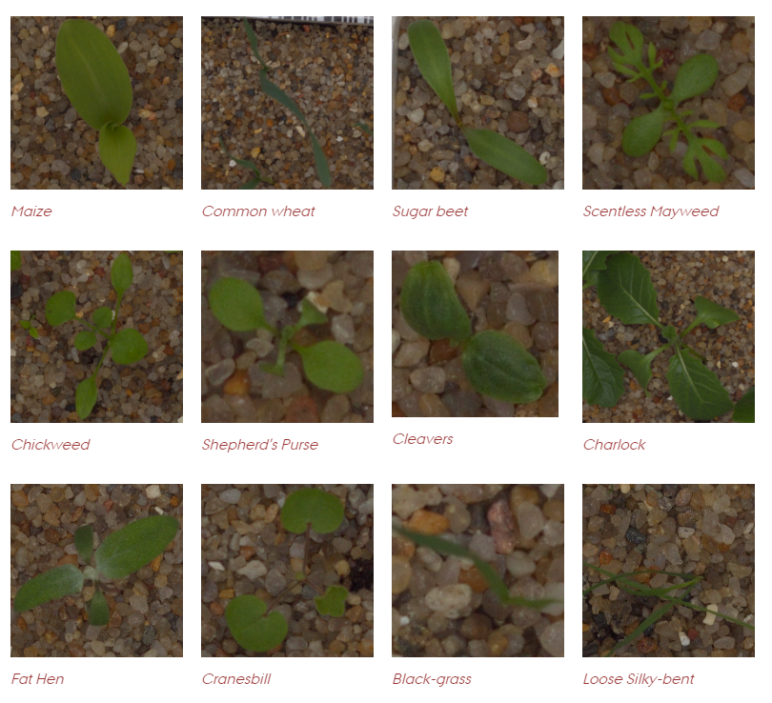
Introduction
Data from Aarhus University
Contains over 3000 images and 12 different species
Data set trained on was Segmented Version.
Used 80% for training data 20% for testing
Figure 1: All plant species in data set

Slide 3
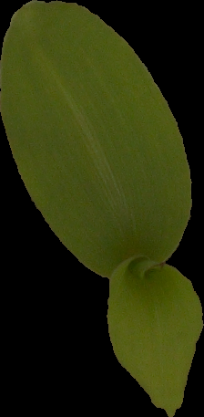
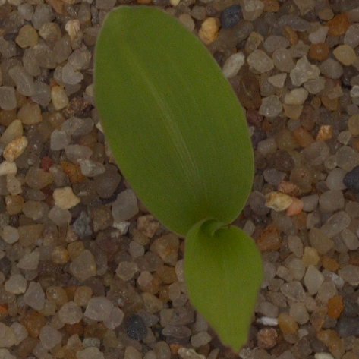
Segmented vs. Unsegmented Data
Data used was Segmented
Easier to train
Unsegmented data set presented many uncontrollable variables
Figure 2: Left: Segmented Maize Plant
Right: Unsegmented Maize plant

Slide 4
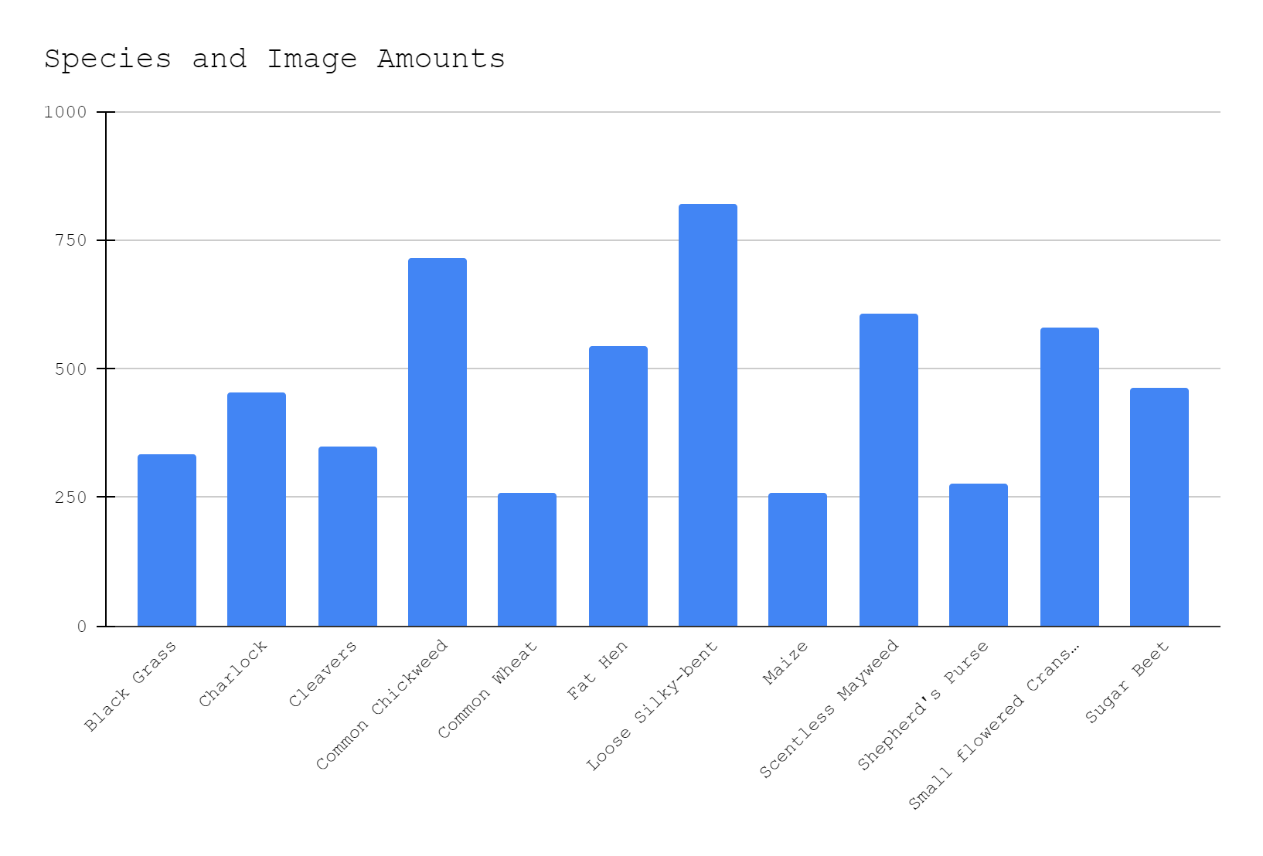
Preprocessing
Data Initially unlabeled.
RGB Values placed into numpy array using Pillows
Encoded from 0 - 11
Initially data unbalanced, was made symmetric
Not all images same size, resized before placing
Figure 3: Initial Data Distribution

Slide 5
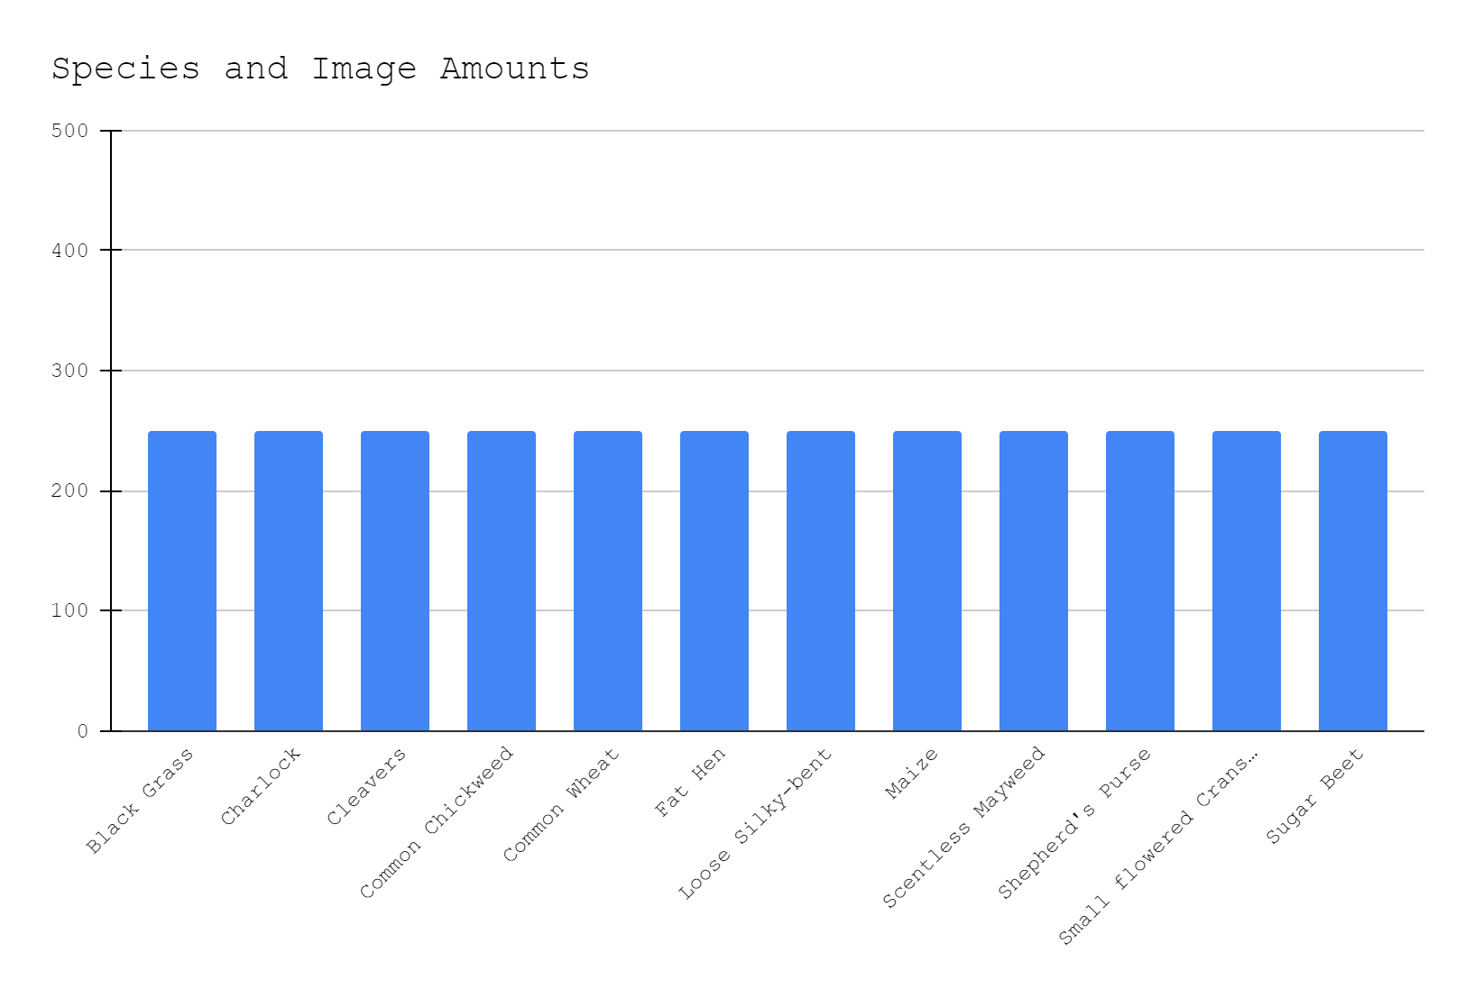
After
Undersampling
Figure 4: All data after undersampling (250 each)

Slide 6
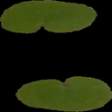

Example
of Resizing
Images weren’t same dimensions
Images resized
Allowed all images to have same dimensions and features
Figure 5: Up: Resized Image to 36 x 36 pixels Right: original image in data set

Slide 7
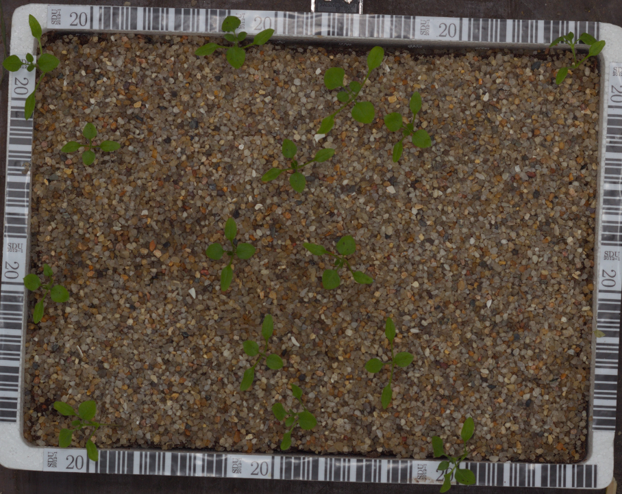
Overall Result
Highest Accuracy Throughout All Models?
About 80% (Misleading)
Explained Later…
Figure 6: Images of Chickweeds from sample

Slide 8
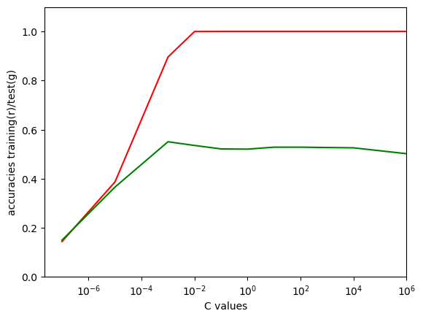
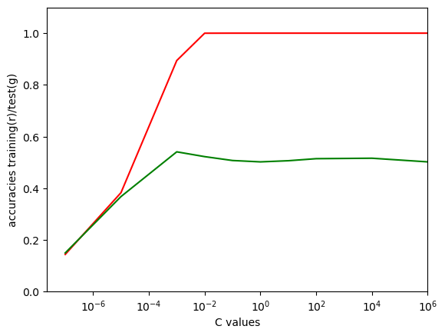
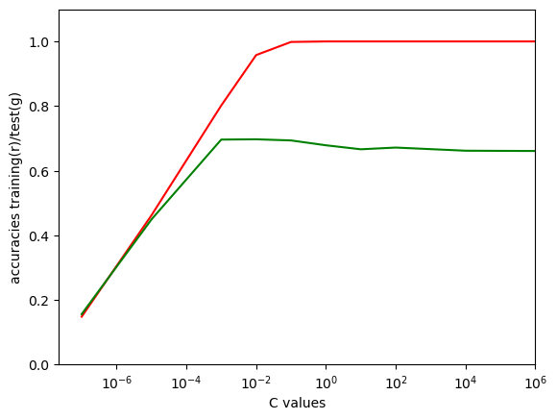
Logistic Regression
Trained With:
Feature transforms: Squared, Cubed, and None
Image Dimensions: 36 x 36, 50 x 50, 128 x 128 pixels
L2/L1 Regularization with Inverse regularization strengths of [0.0000001, 0.00001, 0.001, 0.01, 0.1, 1, 10, 100, 10000, and 1000000]
Figure 7: Graphs of some models against C values

Slide 9
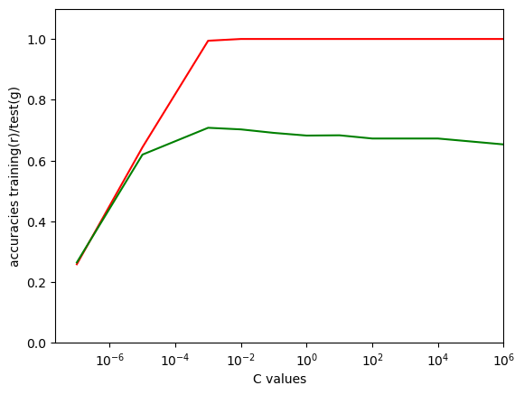
The Best Model?
Best Accuracy: 70.76% (Trained on All Data)
Model: Inverse regularization of 1e-5, No feature transforms, 128 x 128 pixels.
Figure 8: Graph of Best model against C values

Slide 10
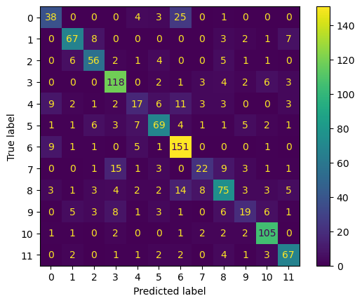
Is that Actually True?
Trained on All data (imbalanced set)
What does confusion matrix say?
Model training on the most present data
Ignoring least present data in testing
So what is the real best model?
Figure 9: Confusion Matrix of best model on all data

Slide 11
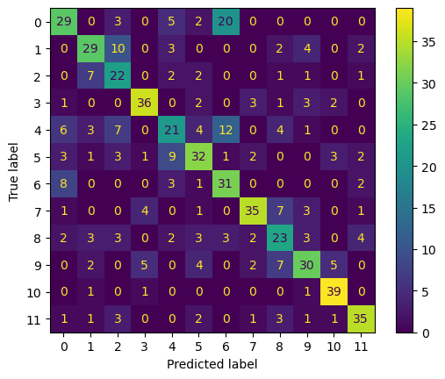
Actual Best Model
Accuracy 60.37%
No Feature Transforms, 50 x 50, inverse regularization strength of .001
AVG Precision: 0.603
AVG Recall: 0.602
Figure 10: Confusion matrix for best model on undersampled data

Slide 12
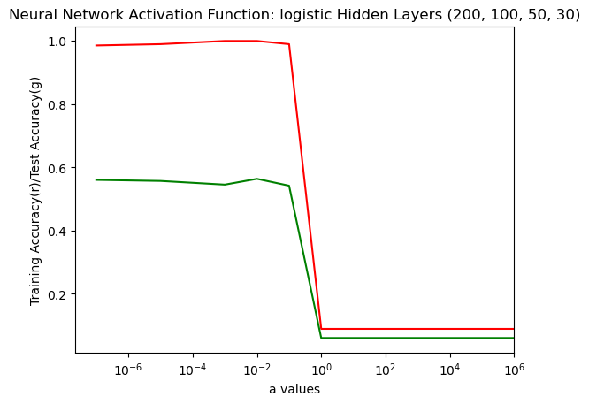
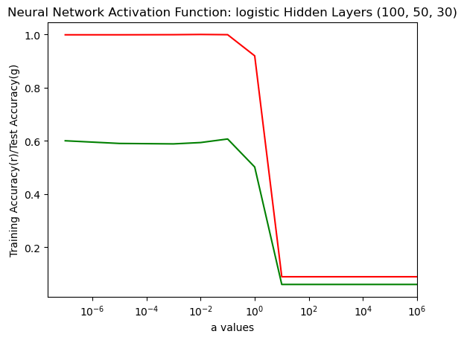
Neural Networks
Image Dimensions as 36 x 36
Hidden Layers Combos: [100], [100, 50], [100, 50, 30], [200, 100, 50, 30]
Activation Functions: RELU, tanh, Logistic
L2 Regularization with regularization strengths of [0.0000001, 0.00001, 0.001, 0.01, 0.1, 1, 10, 100, 10000, and 1000000]
Figure 11: Graphs of accuracies versus regularization strengths for some models

Slide 13
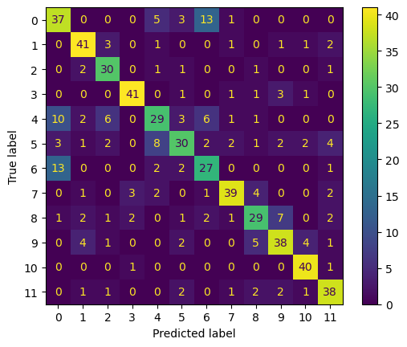
Best Model?
Best Accuracy: 83.83% (Trained on All Data)
Model: tanh, [100], regularization strength: 10
Best Accuracy: 72.41% (Undersampled)
Model: RELU, [200,100,50,30] regularization strength: 1
AVG Precision: 0.702
AVG Recall: 0.69
Figure 12: Confusion matrix for the best model on undersampling

Slide 14
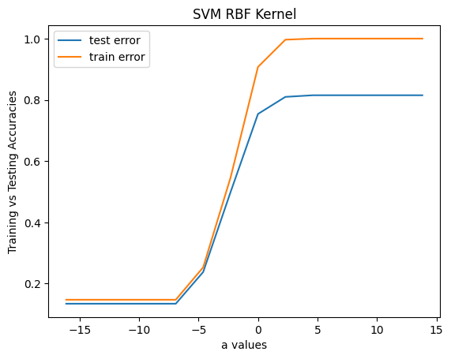
SVM
Image Dimensions as 36 x 36
Kernel functions: Linear, Radial basis, Polynomial
L2 Regularization with regularization strengths of [0.0000001, 0.00001, 0.001, 0.01, 0.1, 1, 10, 100, 10000, and 1000000]
Figure 13: SVM RBF Kernel Visualization

Slide 15
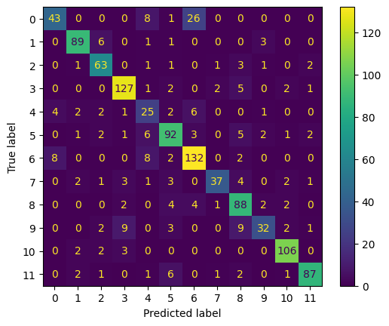
Best Model?
Best Accuracy: 81.5%
Model: RBF kernel
Figure 12: Confusion matrix for the best model on RBF kernel with C = 1000

Slide 16
Conclusion
Best Model
Neural Networks unsampled Relu [200, 100, 50, 30] Accuracy of 72.41%
Conclusions
Training on fully sampled (biased) data leads to misleading results
Overfitted data on higher feature transforms
Changes in pixel sizes led to minimal accuracy changes
Improvements
Collect more data (had to undersample)
All data as squares (No need for resizing)
Trying different transforms and layers

Slide 17
Works Cited
https://vision.eng.au.dk/plant-seedlings-dataset/
https://scikit-learn.org/stable/modules/generated/sklearn.metrics.ConfusionMatrixDisplay.html#sklearn.metrics.ConfusionMatrixDisplay
https://python-pillow.org/
https://matplotlib.org/stable/index.html
Sample report and slides MeiNa Xie, Winnie Zheng

